Slide 1
Introduction to Java for C++ Programmers
Inner Classes and Anonymous Classes in Java, Event Driven Programming using Swing, and JavaFX
Professor: Reza Khojasteh

Slide 2
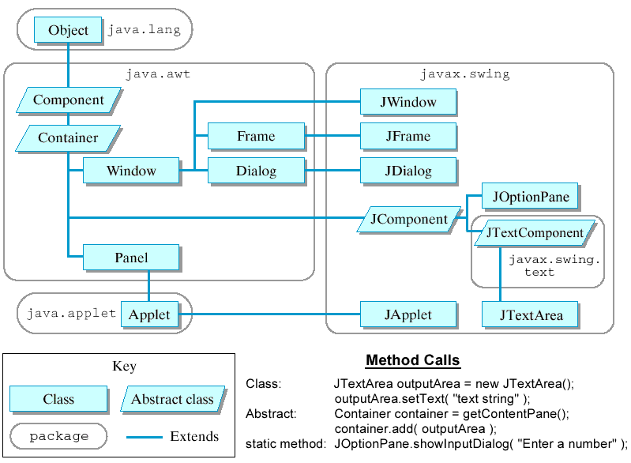
AWT and Swing

Slide 3
Swing in Java
Check Addition.java to see how to use JOptionPane for input and output in Java.
Check Label project to see how to use JLabels with text and icons in Java.
Check TextField project to see how to use JTextFields and JPasswordFields in Java. That’s also an into to Inner Classes in Java.
Check Button project to see how to use Command buttons (JButtons) and action events in Java.

Slide 4
Swing in Java (Cont’d)
Intro to Anonymous Inner classes in Java
Check Button2 project to see how to see an into to Anonymous Inner Classes in Java.
Check TextArea to see how to use JTextAreas (providing an area for manipulating multiple lines of text) in Java.

Slide 5
Java FX
Swing will not receive any further enhancements.
JavaFX is a new framework for developing Java GUI programs. In JavaFX, you have stages (as the platform) to support the scenes, and nodes as actors to perform in the scenes.
Check MyJavaFX.java, MultipleStageDemo.java, and ButtonInPane.java to have some idea!
Notes:
Reference: Chapter 14, Introduction to Java Programming (brief version), 11th ed., by Y. Daniel Liang, Pearson.

